Slide 1
DS6390 Case Study 2: Report to Story
By Ben Goodwin

Slide 2
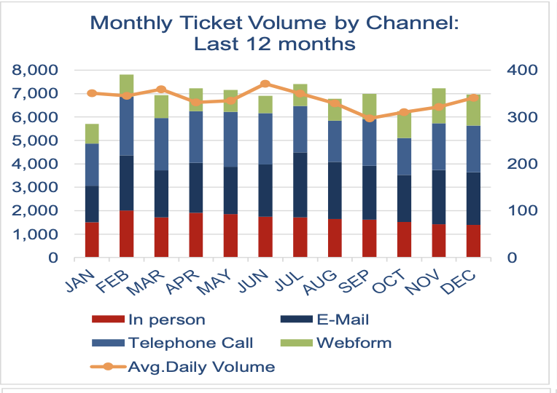
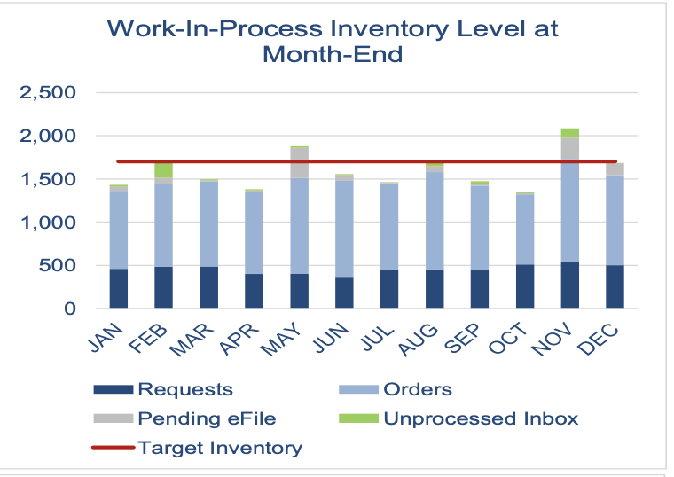
1) First practice putting the takeaway for each graph into words
“Monthly Ticket Volume by Channel: Last 12 Months”
This chart is visualizing the monthly ticket volume totals broken down into channels. Those channels are in person, telephone, email, webform, and avg.daily volume. This chart seeks to show the overall trend of ticket volume, while also being broken down by channel by using a stacked bar chart. The takeaway: Ticket volume is consistent year-round; the breakdown of channels varies during the time period.
“Work-in-Process inventory level at month-end.” This visualization aims to show the audience a few pieces of information including the breakdown of work-in-process inventory. It also shows a target line of how the goal was exceeded or missed. The takeaway: The target inventory level is usually not met.

Slide 3
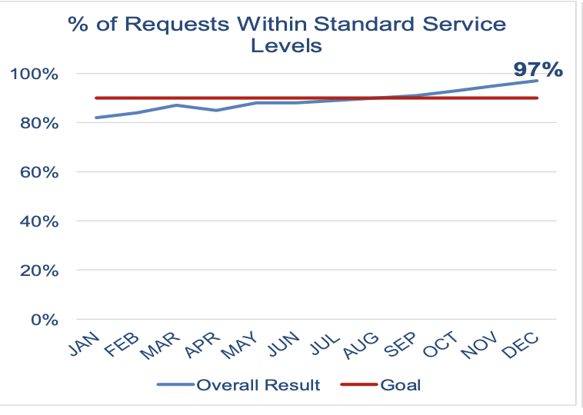
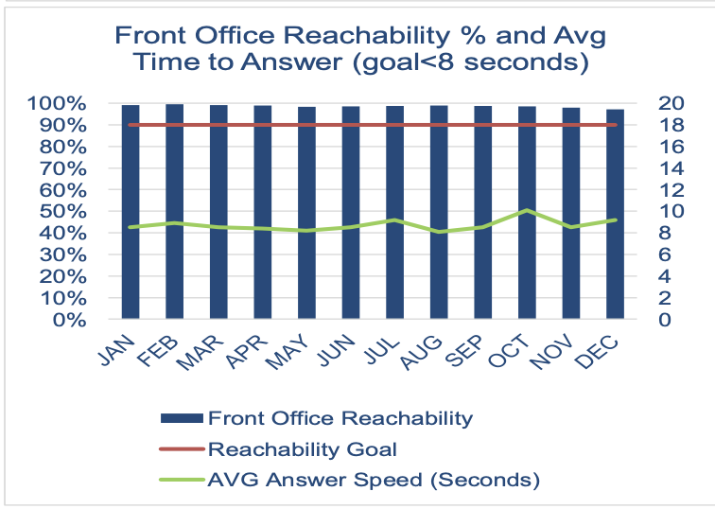
1) First practice putting the takeaway for each graph into words
“% of Requests Within Standard Service levels”
This chart is visualizing a projected goal of anticipated service levels vs the actual level of service delivered. This chart follows the data over the course of the year. The takeaway: During first half of year % of requests were below standard service levels, but the trend changes mid-year.
“Front Office Reachability % and average”. The visualization aims to show what percentage of time the front office is available and secondarily the chart shows the average time to answer. The takeaway: Front office achieves greater than 95% reachability and average answer speed on average exceeds goal.

Slide 4
2) Do we need all this data?
Lots of data is contained in the four charts- some of which may be repetitive and unnecessary.
The story I am interested in telling: How is our company responding to all the tickets through the different channels and how quickly can we respond to them?
If we aim on telling a story of ticket volume and the company's ability to handle and respond to all these tickets, I believe that the charts below tell the best and most compelling story regarding the story I have chosen.

Slide 5
2) Do we need all this data?
If I am focused on these question at hand. The charts below tell the most compelling visual story of that question. The first chart answers the question of the company’s ability to answer and respond to those requests. Not only measuring their ability to respond to calls, but how quickly and how often they were available.
The second chart tells the other side of this story. This chart breaks down each of the channels and how they change over time.
As previously stated, these charts tell the same story, but from different sides.

Slide 6
3) How would you show the data?

Slide 7
How will you incorporate words?
The visual shows that as overall channel volume increases, front office reliability actually decreases.
This is important because during the middle of the year as the cumulative channel volume increases, the front office has an issue keeping up with the reliability.
The front office reliability should be increased during these busy months

